Slide 1
My VIP-CSL Experience at Arts Council - Windsor & Region (ACWR)
Amey Mahendra Thakur,
MEng - Electrical & Computer Engineering,
University of Windsor

Slide 2
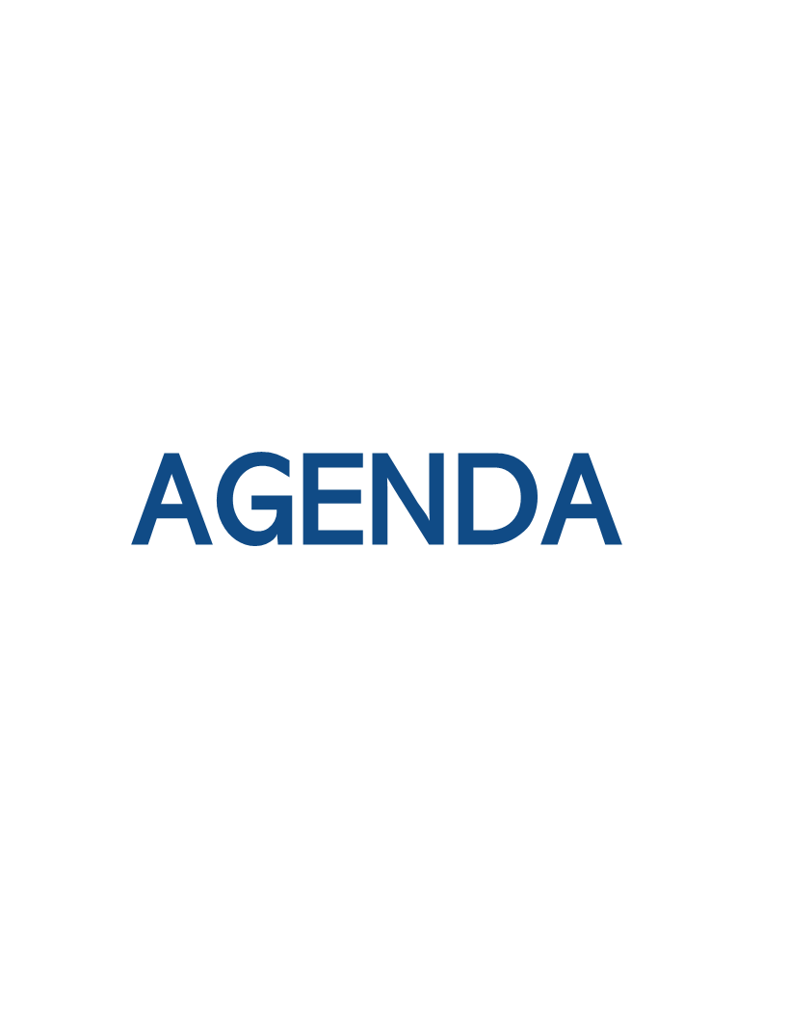
VIP-CSL Role
Skill Development
STAR Interview Answer
Future Plans

Slide 3
About me - Amey Thakur
Who I Am: Computer Engineer, Full Stack Developer and AI enthusiast
Academic Voyage: Final year, MEng in Electrical & Computer Engineering, University of Windsor
Aspiring Vision: To pioneer in AI, shaping the future with smart solutions.
Next Frontier: Embarking on a PhD journey

Slide 4

VIP-CSL Role
VIP-CSL Role
Position: Data Analyst and Outreach Assistant
Key Responsibilities:
Analyze survey data from local artists
Assist in preparing the year-in-review report
Collaboration:
Worked closely with outreach team
Engaged with artist community for feedback via survey
Impact:
Plan to provided insights to shape marketing initiatives
Understand artist needs and preferences

Slide 5


Skill Development
Data Analysis:
Extracted actionable insights from given dataset to create questionnaire
Applied statistical methods for survey analysis
Communication:
Effectively communicated findings to the team
Clearly articulated survey objectives to artists
Project Management:
Led the data collection and analysis phase

Slide 6
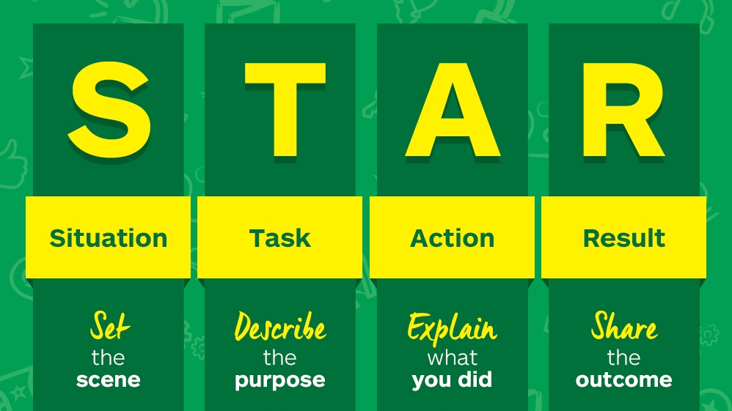
STAR Interview Answer
Situation
Task
Action
Result

Slide 7
Future Plans and Community Involvement
Ongoing ACWR Involvement:
Continuing to support ACWR with data analysis
Assist in preparing the year-in-review report
Community Engagement:
Seeking opportunities to contribute in community projects

Slide 8
Thank You

